Slide 1


Shi Chuanhua
17 Jun 2024

Slide 2

Outline
Executive Summary
Introduction
Methodology
Results
Conclusion
Appendix

Slide 3
Executive Summary
Summary of methodologies
Data Collection through API
Data Collection with Web Scraping
Data Wrangling
Exploratory Data Analysis with SQL
Exploratory Data Analysis with Data Visualization
Interactive Visual Analytics with Folium
Machine Learning Prediction
Summary of all results
Exploratory Data Analysis result
Interactive analytics in screenshots
Predictive Analytics result

Slide 4
Introduction
Project background and context
SpaceX advertises Falcon 9 rocket launches on its website at a cost of 62 million dollars; other providers cost upward of 165 million dollars each, and much of the savings is because SpaceX can reuse the first stage. Therefore if we can determine if the first stage will land, we can determine the cost of a launch. This information can be used if an alternate company wants to bid against SpaceX for a rocket launch.
Problems you want to find answers
How payload mass, launch site, number of flights, and orbits affect the first-stage landing success
Rate of successful landings in different circumstances.
Which is the best predictive model for successful landing

Slide 5

Section 1

Slide 6
Methodology
Executive Summary
Data collection methodology:
Data collected via Space X API as well as Wikipedia web scraping
Perform data wrangling
Data was transformed to the formats that allow data analytics, additional steps were taken to deal with missing values and create an outcome column for binary classification.
Perform exploratory data analysis (EDA) using visualization and SQL
Perform interactive visual analytics using Folium and Plotly Dash
Perform predictive analysis using classification models
Data collected were normalized, split into test and train data, evaluated using different techniques.

Slide 7
Data Collection
Describe how data sets were collected.
You need to present your data collection process use key phrases and flowcharts

Slide 8
Data Collection – SpaceX API
Call API to retrieve then parse the data
Filter the data to include only Falcon 9
Dealing with the missing values
Present your data collection with SpaceX REST calls using key phrases and flowcharts
https://github.com/Chuanhua512/IBMDataScience/blob/main/Module%201/jupyter-labs-spacex-data-collection-api.ipynb

Slide 9
Data Collection - Scraping
Retrieve the wiki page content using beautifulsoup
Extract the relevant header & values using the respective HTML tags
Joined the extracted data into a Dataframe
Present your web scraping process using key phrases and flowcharts
https://github.com/Chuanhua512/IBMDataScience/blob/main/Module%201/jupyter-labs-webscraping.ipynb

Slide 10
Data Wrangling
Data wrangling was done using Pandas
https://github.com/Chuanhua512/IBMDataScience/blob/main/Module%201/labs-jupyter-spacex-Data%20wrangling.ipynb
Load the csv file into Pandas DataFrame
Verify if there is null or missing values.
Identify which columns are numerical and categorical
Calculate the key figures for each category
Create new column that use numeric to represent the success or fail of an launch

Slide 11
EDA with Data Visualization
Summarize what charts were plotted and why you used those charts
I made use of scatter charts to observe if the following pairs are related
flight numbers vs success rate of the launch sites
payload and the success rate of the launch sites.
Orbit and the Flight number
Orbit and the payload mass
Then I use a bar chart to illustrate the success rate of each orbit, a line chart to show the trend over the year
https://github.com/Chuanhua512/IBMDataScience/blob/main/Module%202/edadataviz.ipynb

Slide 12
EDA with SQL
Using bullet point format, summarize the SQL queries you performed
Retrieve the unique launch sites in the space mission
Display 5 records where launch sites begin with the string 'CCA’
Display the total payload mass carried by boosters launched by NASA (CRS)
Display average payload mass carried by booster version F9 v1.1
List the date when the first succesful landing outcome in ground pad was acheived.
List the names of the boosters which have success in drone ship and have payload mass greater than 4000 but less than 6000
List the total number of successful and failure mission outcomes
List the names of the booster_versions which have carried the maximum payload mass. Use a subquery
List the records which will display the month names, failure landing_outcomes in drone ship ,booster versions, launch_site for the months in year 2015.
Rank the count of landing outcomes (such as Failure (drone ship) or Success (ground pad)) between the date 2010-06-04 and 2017-03-20, in descending order.
https://github.com/Chuanhua512/IBMDataScience/blob/main/Module%202/jupyter-labs-eda-sql-coursera_sqllite.ipynb

Slide 13
Build an Interactive Map with Folium
Summarize what map objects such as markers, circles, lines, etc. you created and added to a folium map
Markers are used to indicate the launch sites, circles are used to highlight the surroundings of NASA JSC & the launch sites, lines were used to display the distance between the launch site & specified coordinates.
Explain why you added those objects
They were used for ease of identification for the objects.
https://github.com/Chuanhua512/IBMDataScience/blob/main/Module%203/lab_jupyter_launch_site_location.ipynb

Slide 14
Build a Dashboard with Plotly Dash
I have created a dashboard with Pie charts that show the success count of each site, and within each site, there’s another Pie chart that displays the success rate of the respective site. This allows us to interpret which site has the highest success rate.
I have also created a scatter plot that compares the Payload mass and the success rate, the plots are differentiated by booster versions using different colours, so we can judge which booster tends to have a higher rate of success.
https://github.com/Chuanhua512/IBMDataScience/blob/main/Module%203/spacex_dash_app.py

Slide 15
Predictive Analysis (Classification)
Summarize how you built, evaluated, improved, and found the best performing classification model
You need present your model development process using key phrases and flowchart
Add the GitHub URL of your completed predictive analysis lab, as an external reference and peer-review purpose

Slide 16
Results
Exploratory data analysis results
Interactive analytics demo in screenshots
Predictive analysis results

Slide 17

Section 2

Slide 18
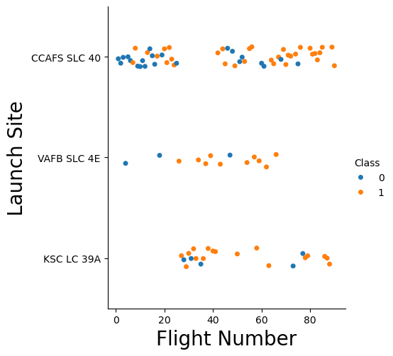
Flight Number vs. Launch Site
We can deduce that VAFB SLC 4E & KSC LC 39A tend to have a higher success rate

Slide 19
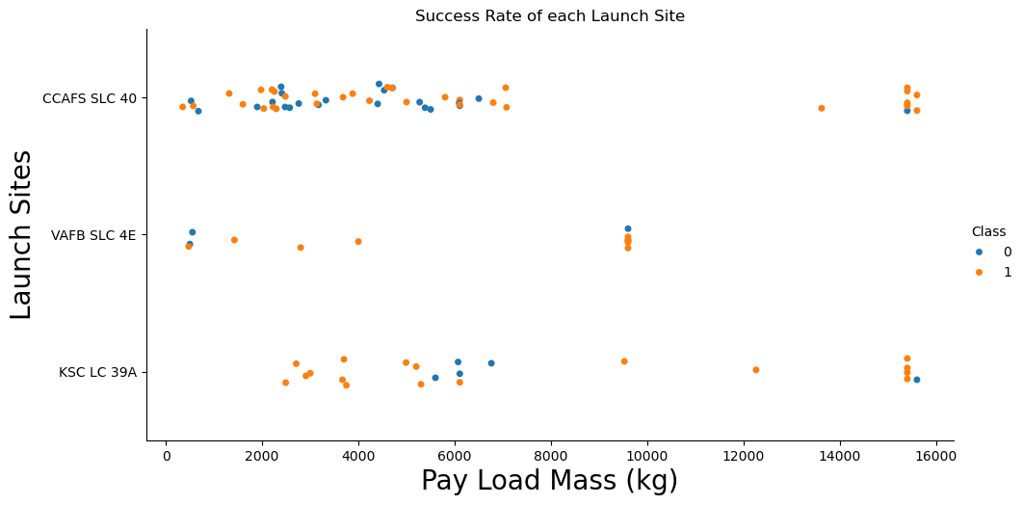
Payload vs. Launch Site
Payload & Launch site don’t seem to have a direct link, we can also tell that VAFB SLC 4E does not have launches with payload higher than 10k

Slide 20
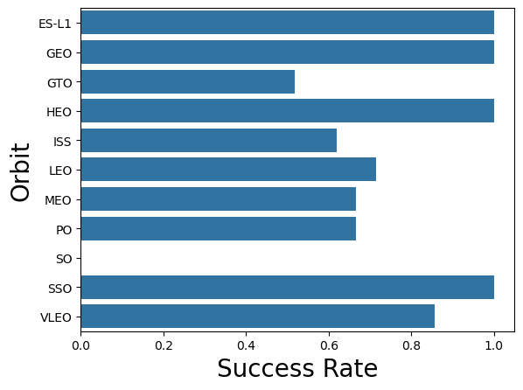
Success Rate vs. Orbit Type
SO orbit has the lowest rate of success, ES-L1,GEO,GTO,HEO & SSO has the highest rate of success.

Slide 21
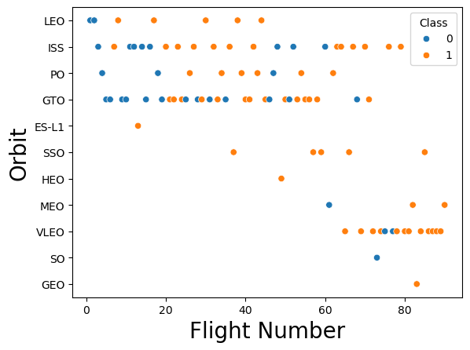
Flight Number vs. Orbit Type
For some of the Orbits like LEO & GTO the rate of success does seem to increase as the flight number increases.

Slide 22
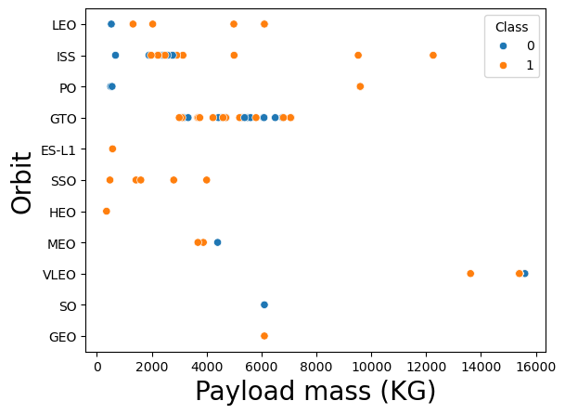
Payload vs. Orbit Type
The Payload mass and Orbit type don’t seem to have a direct link.
For LSS & LEO the heavier the payload the higher the success rate.

Slide 23
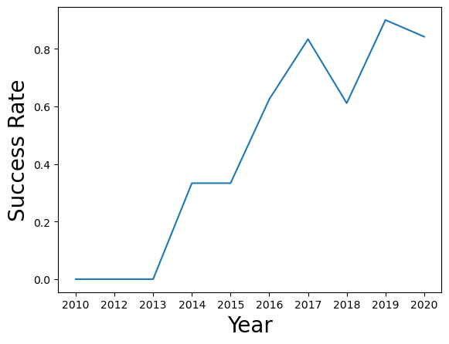
Launch Success Yearly Trend
As the year increases, the launch success rate increases. Likely due to more advance technology.

Slide 24
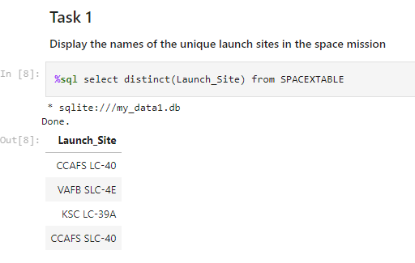
All Launch Site Names
Simply select distinct from the Launch_Site column.

Slide 25
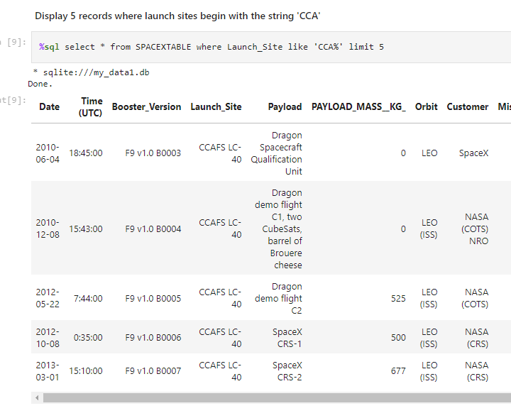
Launch Site Names Begin with 'CCA'
Select all columns from table where Launch_Site like CCA%

Slide 26
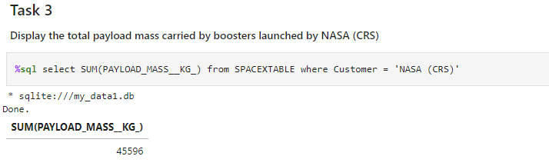
Total Payload Mass
Use SQL to sum the payload mass column where customer is NASA (CRS)

Slide 27
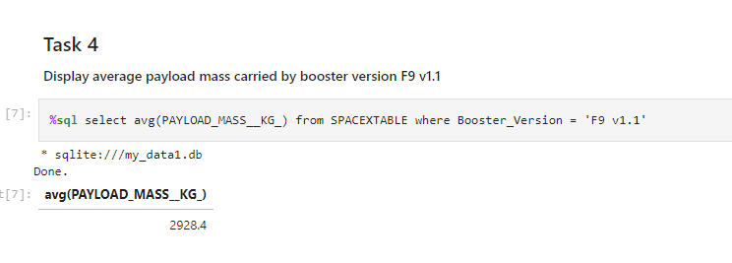
Average Payload Mass by F9 v1.1
Select the average of payload mass column where booster version is F9 V1.1

Slide 28
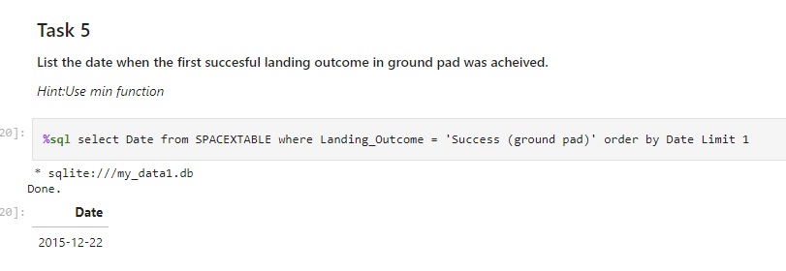
First Successful Ground Landing Date
Select the date where the landing outcome is success gound pad and order by date. Get the first date.

Slide 29
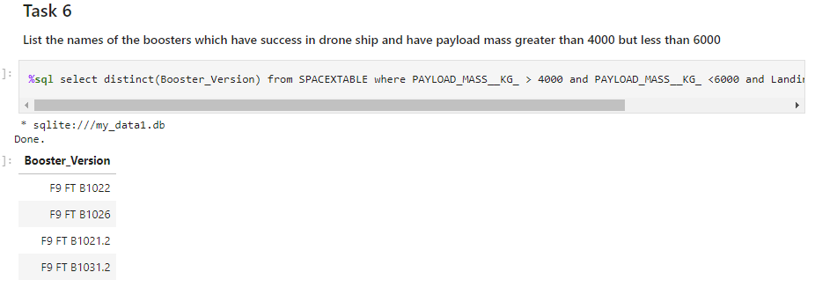
Successful Drone Ship Landing with Payload between 4000 and 6000
List the names of boosters which have successfully landed on drone ship and had payload mass greater than 4000 but less than 6000
Use the SQL query below for the result

Slide 30
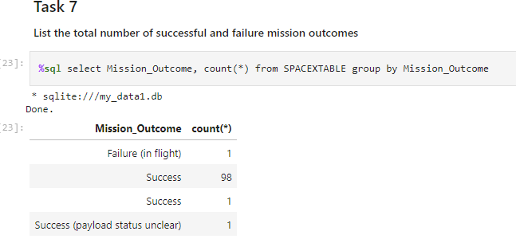
Total Number of Successful and Failure Mission Outcomes
Calculate the total number of successful and failure mission outcomes
Use the query below to get the count of outcome.

Slide 31
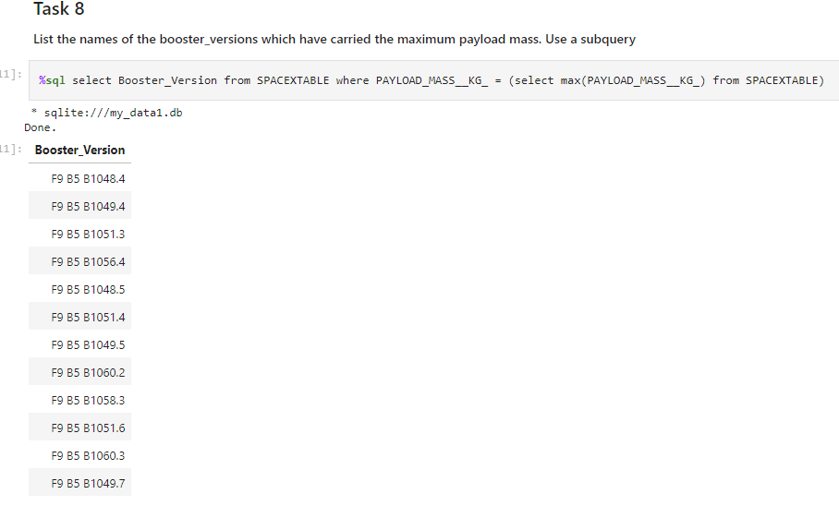
Boosters Carried Maximum Payload
List the names of the boosters which have carried the maximum payload mass
Use the SQL query below to first get the max payload mass, then find the booster version where the payload mass is equals to the max payload mass.

Slide 32
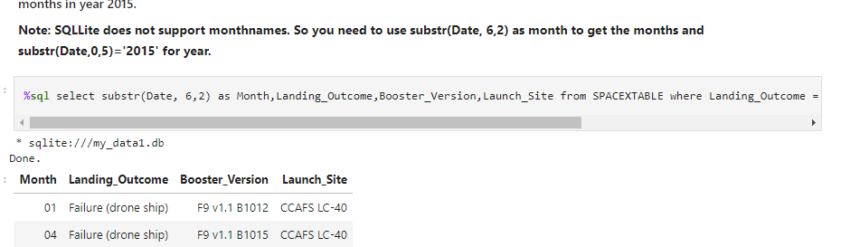
2015 Launch Records
List the failed landing_outcomes in drone ship, their booster versions, and launch site names for in year 2015
Select the respective columns where Landing_Outcome = 'Failure (drone ship)' and substr(Date,0,5)='2015'

Slide 33
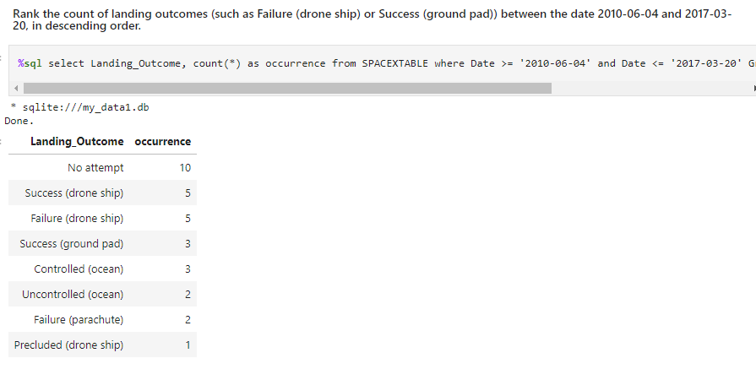
Rank Landing Outcomes Between 2010-06-04 and 2017-03-20
Rank the count of landing outcomes (such as Failure (drone ship) or Success (ground pad)) between the date 2010-06-04 and 2017-03-20, in descending order
Select outcome and count where Date >= '2010-06-04' and Date <= '2017-03-20' Group by Landing_Outcome Order by occurrence desc

Slide 34

Section 3

Slide 35

Launch Site locations
The launch sites are located close to the coast in general. In case of a launch mishap or explosion, debris falls away from the launch pad. An ocean provides a vast, mostly unpopulated area for debris to fall into, minimizing the risk of damage or casualties on land.

Slide 36
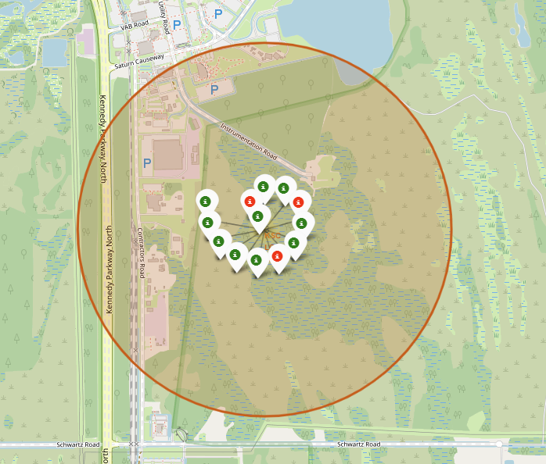
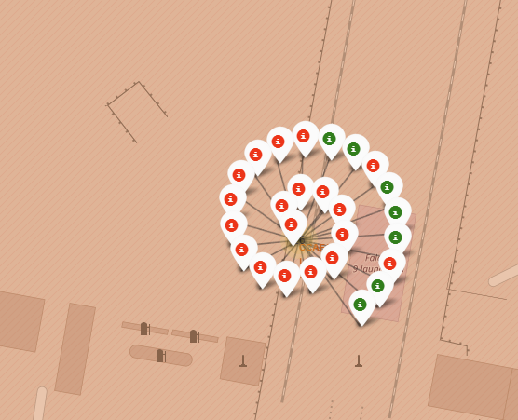
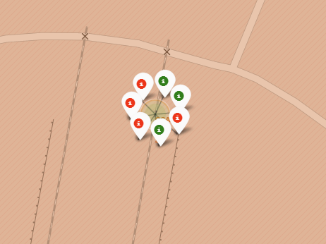
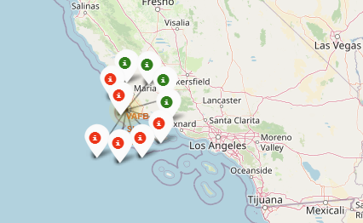
Success Rate shown on map
The visual furnished with the successful and non-successful launch attempts, it provides an overview of the launches and by one look, we can infer that base KLC LC 39A has a higher success launches.

Slide 37
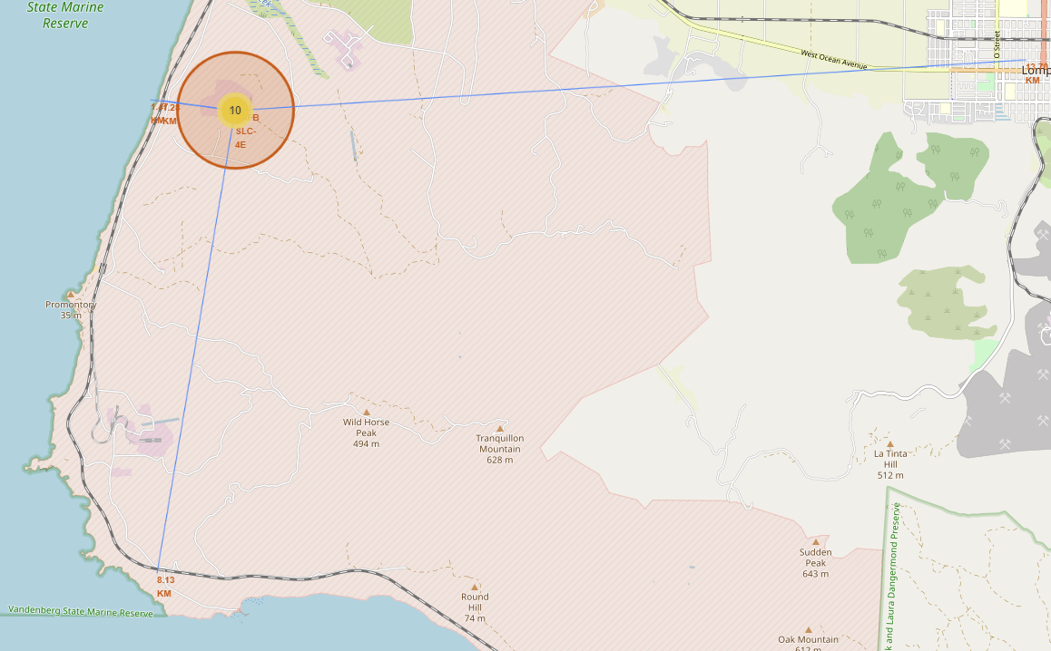
Launch site distances to landmarks
From the map, we can determine that the launch site is generally further away from populations, and it is accessible by rail transport, although the nearest highway is 8KM away, there should be no issue with supplying necessities to the site.

Slide 38

Section 4

Slide 39
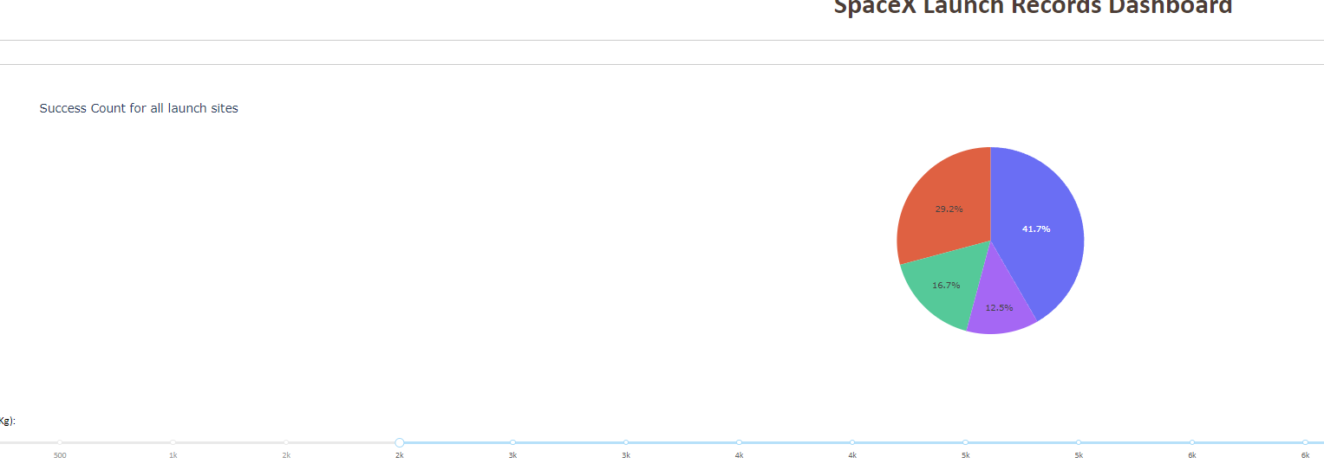
Success count of all sites
This chart shows the total count of successful launch of each sites. However it is important to know that this ratio doesn’t mean a site has high success rate, the success rate for each site should be calculated separately.

Slide 40
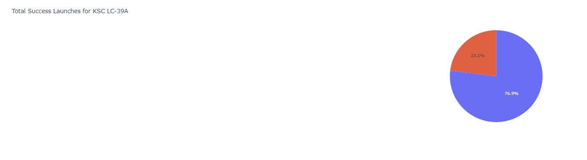
Site with Highest Success Rate
This chart shows the site with the highest success rate, it is a fairer comparison as compared to the pie chart with all sites.

Slide 41
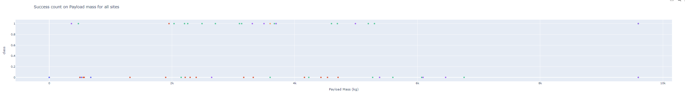
Payload & Launch outcome scatter plot
Payload range below 6K has a higher rate of success, Booster version FT has a higher rate of success.

Slide 42

Section 5

Slide 43
Classification Accuracy
Visualize the built model accuracy for all built classification models, in a bar chart
Find which model has the highest classification accuracy

Slide 44
Confusion Matrix
Show the confusion matrix of the best performing model with an explanation

Slide 45
Conclusions
Point 1
Point 2
Point 3
Point 4
…

Slide 46
Appendix
Include any relevant assets like Python code snippets, SQL queries, charts, Notebook outputs, or data sets that you may have created during this project

Slide 47


